Slide 1
Common Emitter
Bulletproof designs

Slide 2
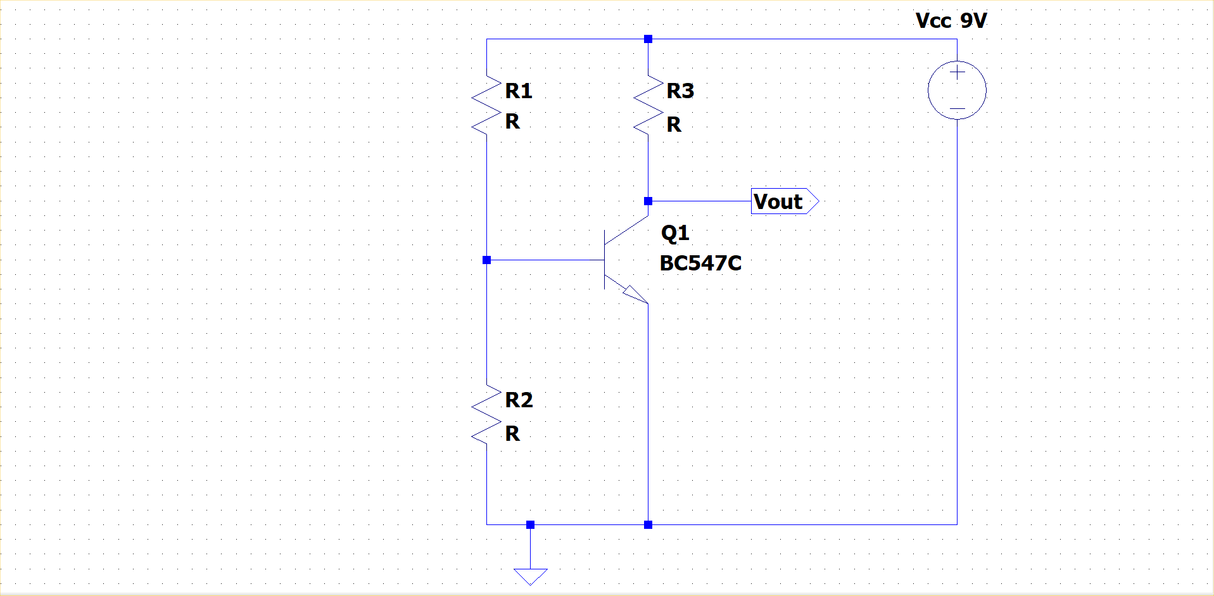
Basic common emitter

Slide 3
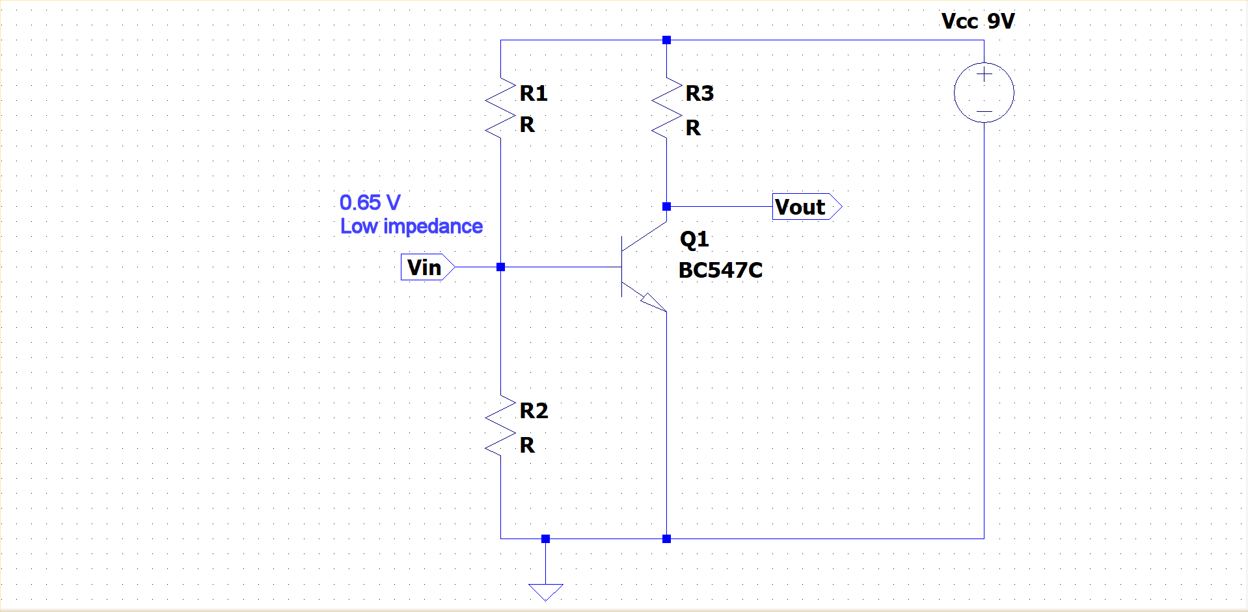
Input level and impedance

Slide 4
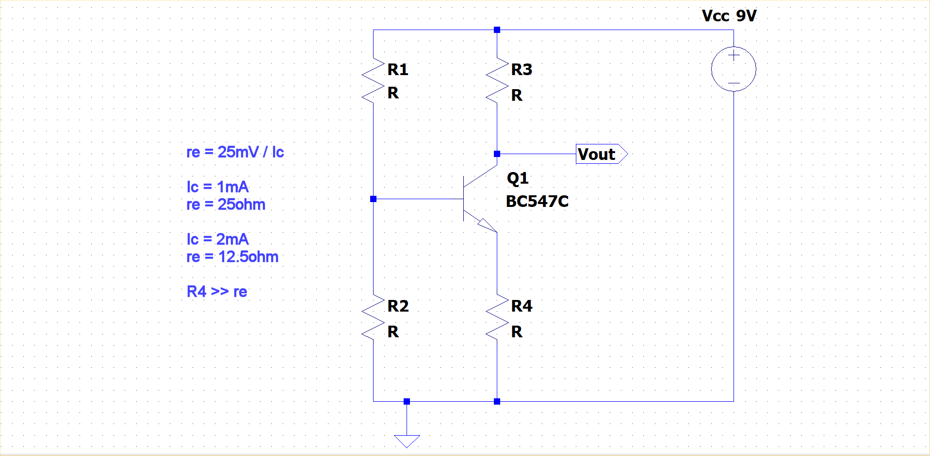
Collector current and emitter resistor

Slide 5
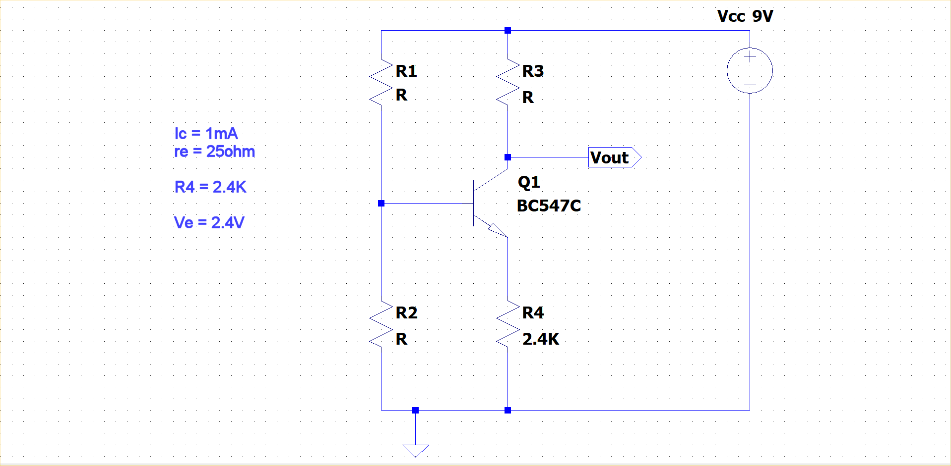
Setting emitter bias voltage

Slide 6
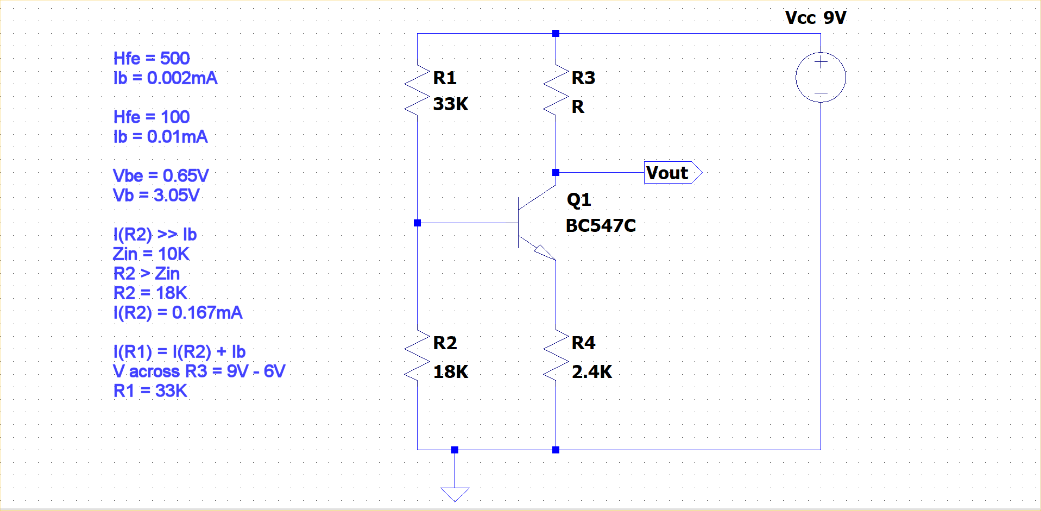
Setting base bias voltage

Slide 7
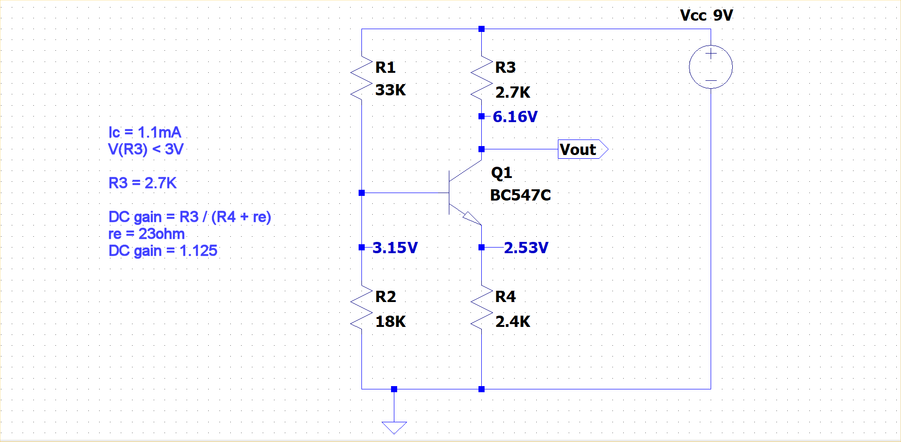
Collector resistor and gain

Slide 8
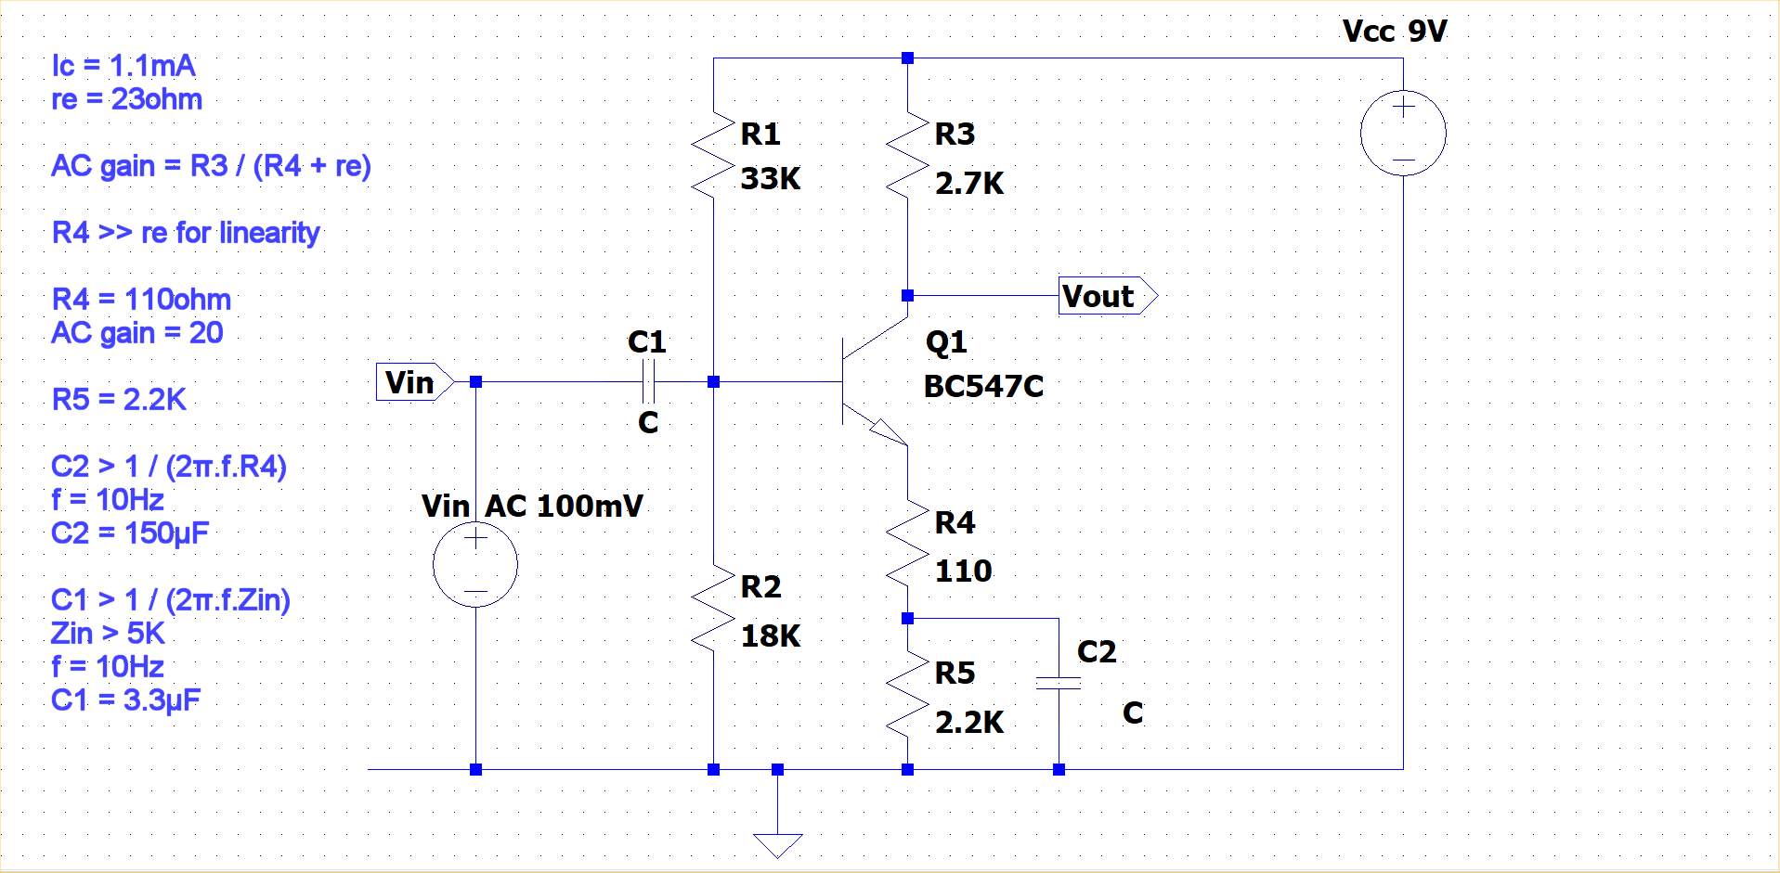
AC gain – split emitter resistor

Slide 9
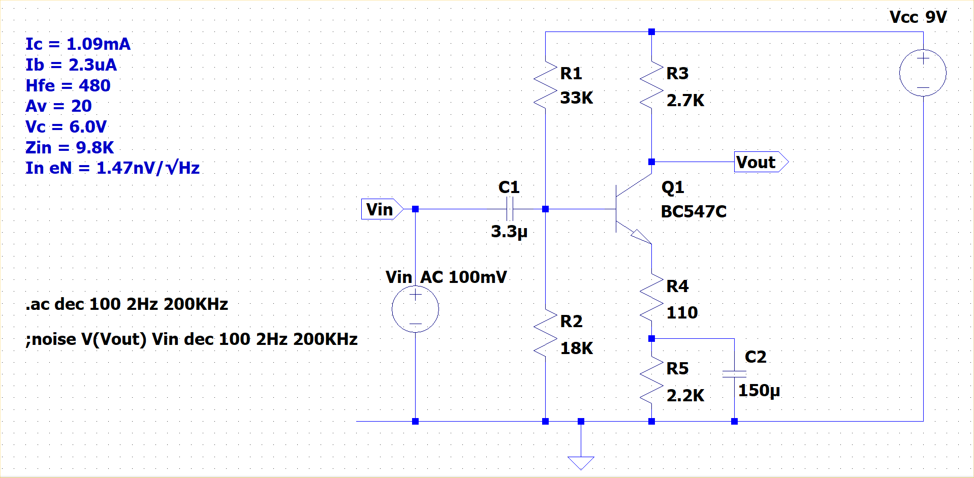
Simulation results

Slide 10
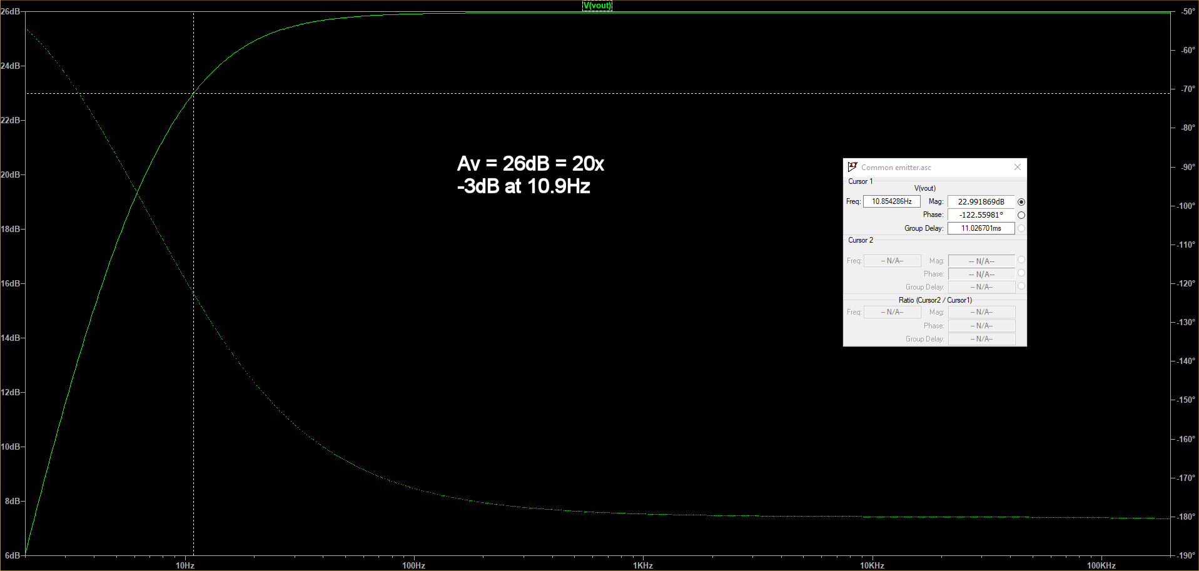
Simulation frequency response

Slide 11
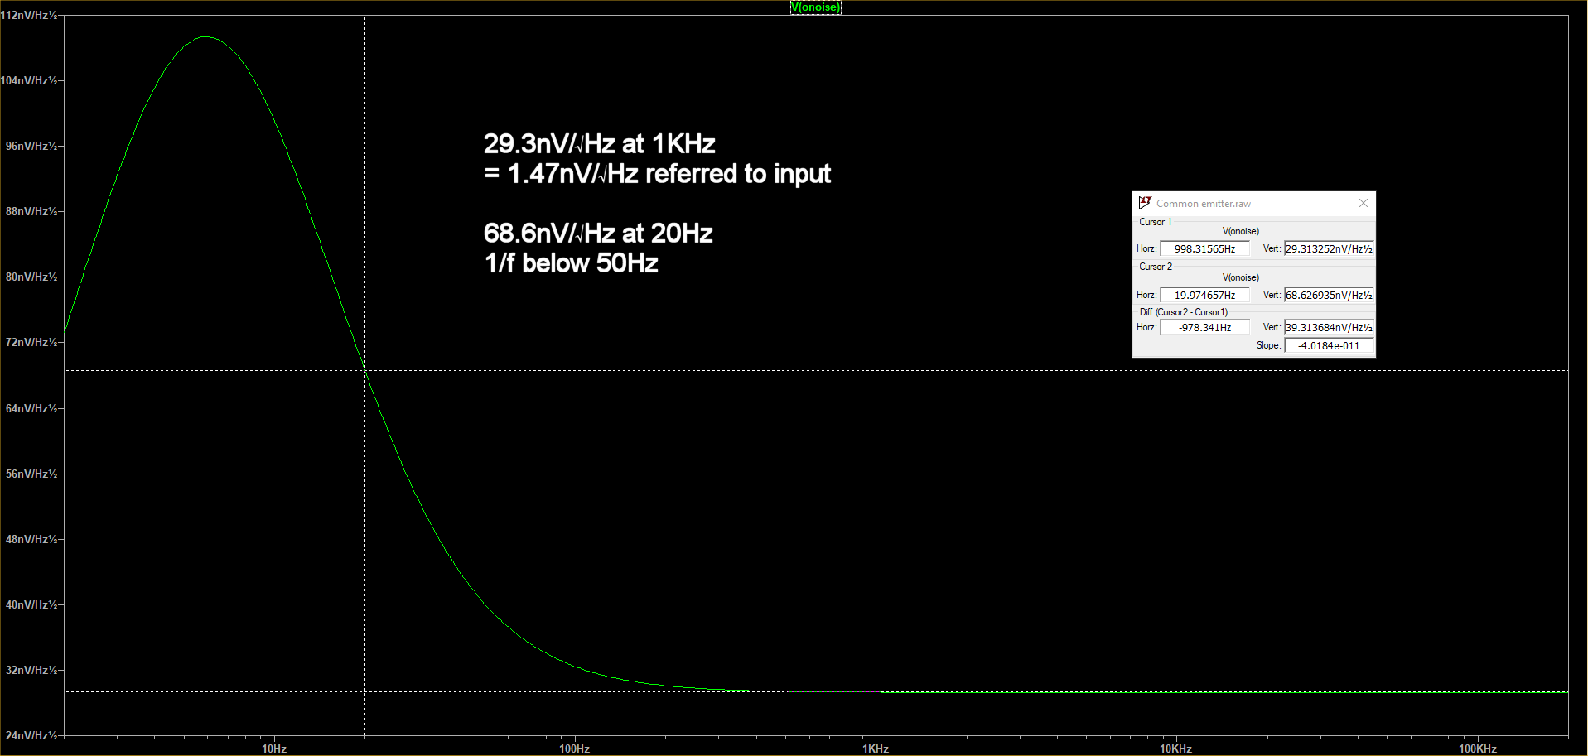
Simulation noise figures

Slide 12
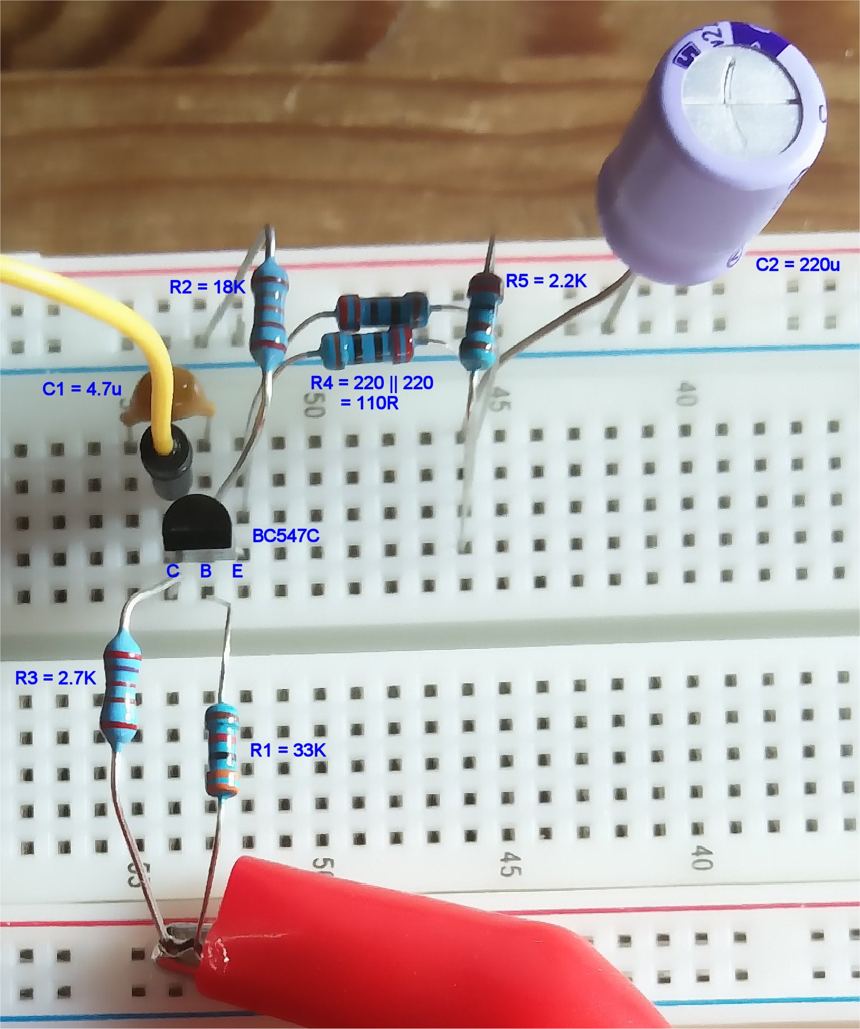
Actual circuit: Ic = 1.08mA

Slide 13
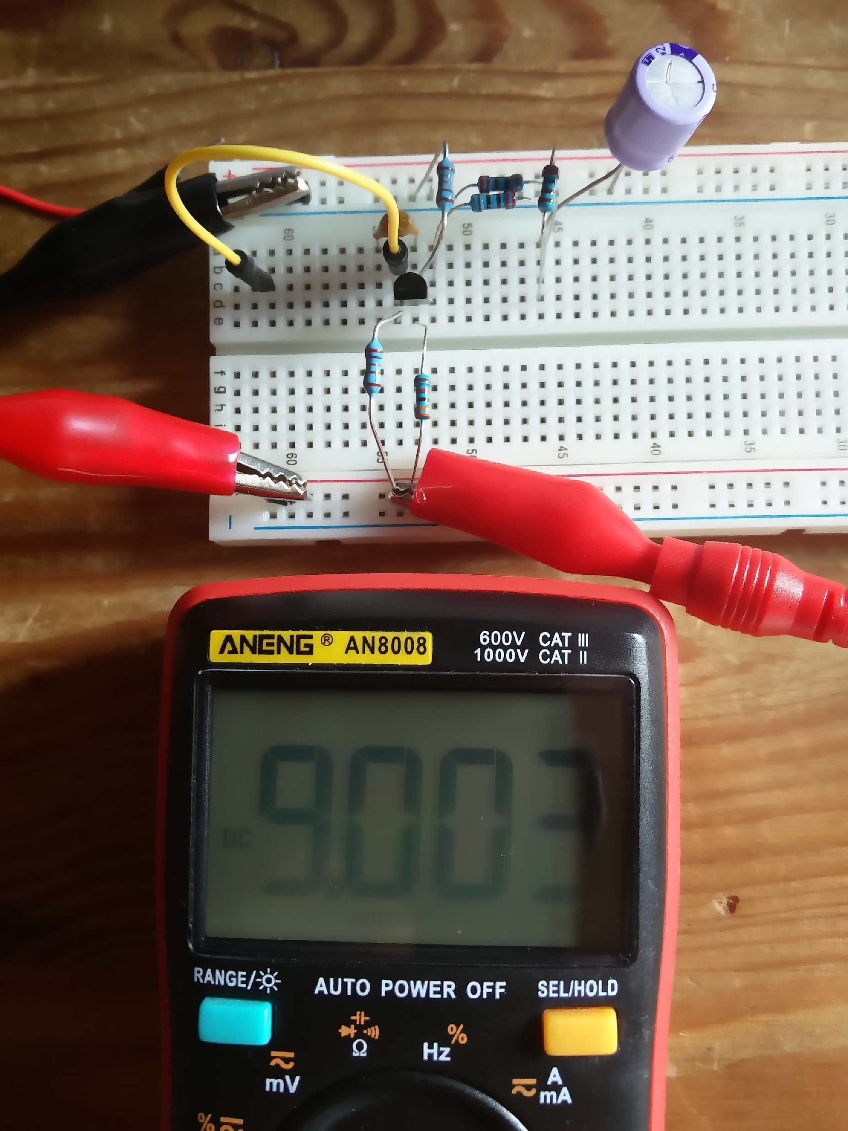
Supply = 9V

Slide 14
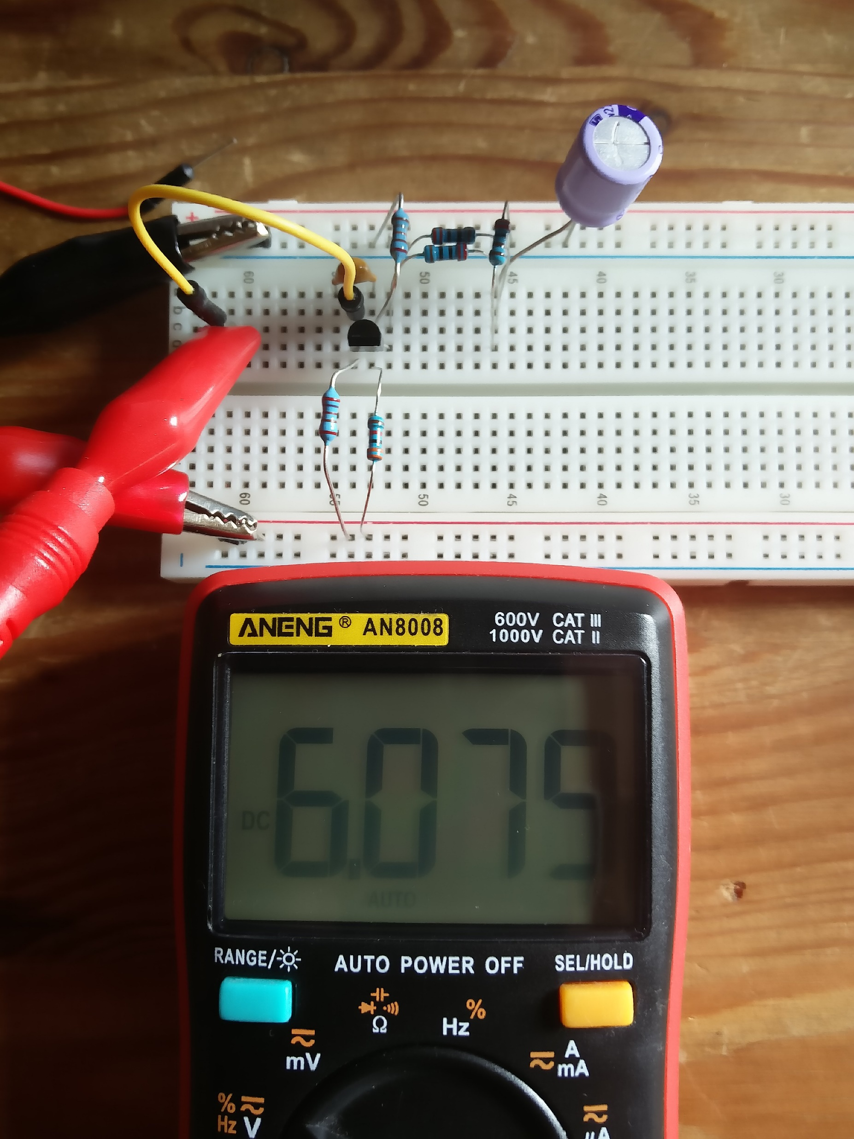
Collector voltage = 6.08V

Slide 15
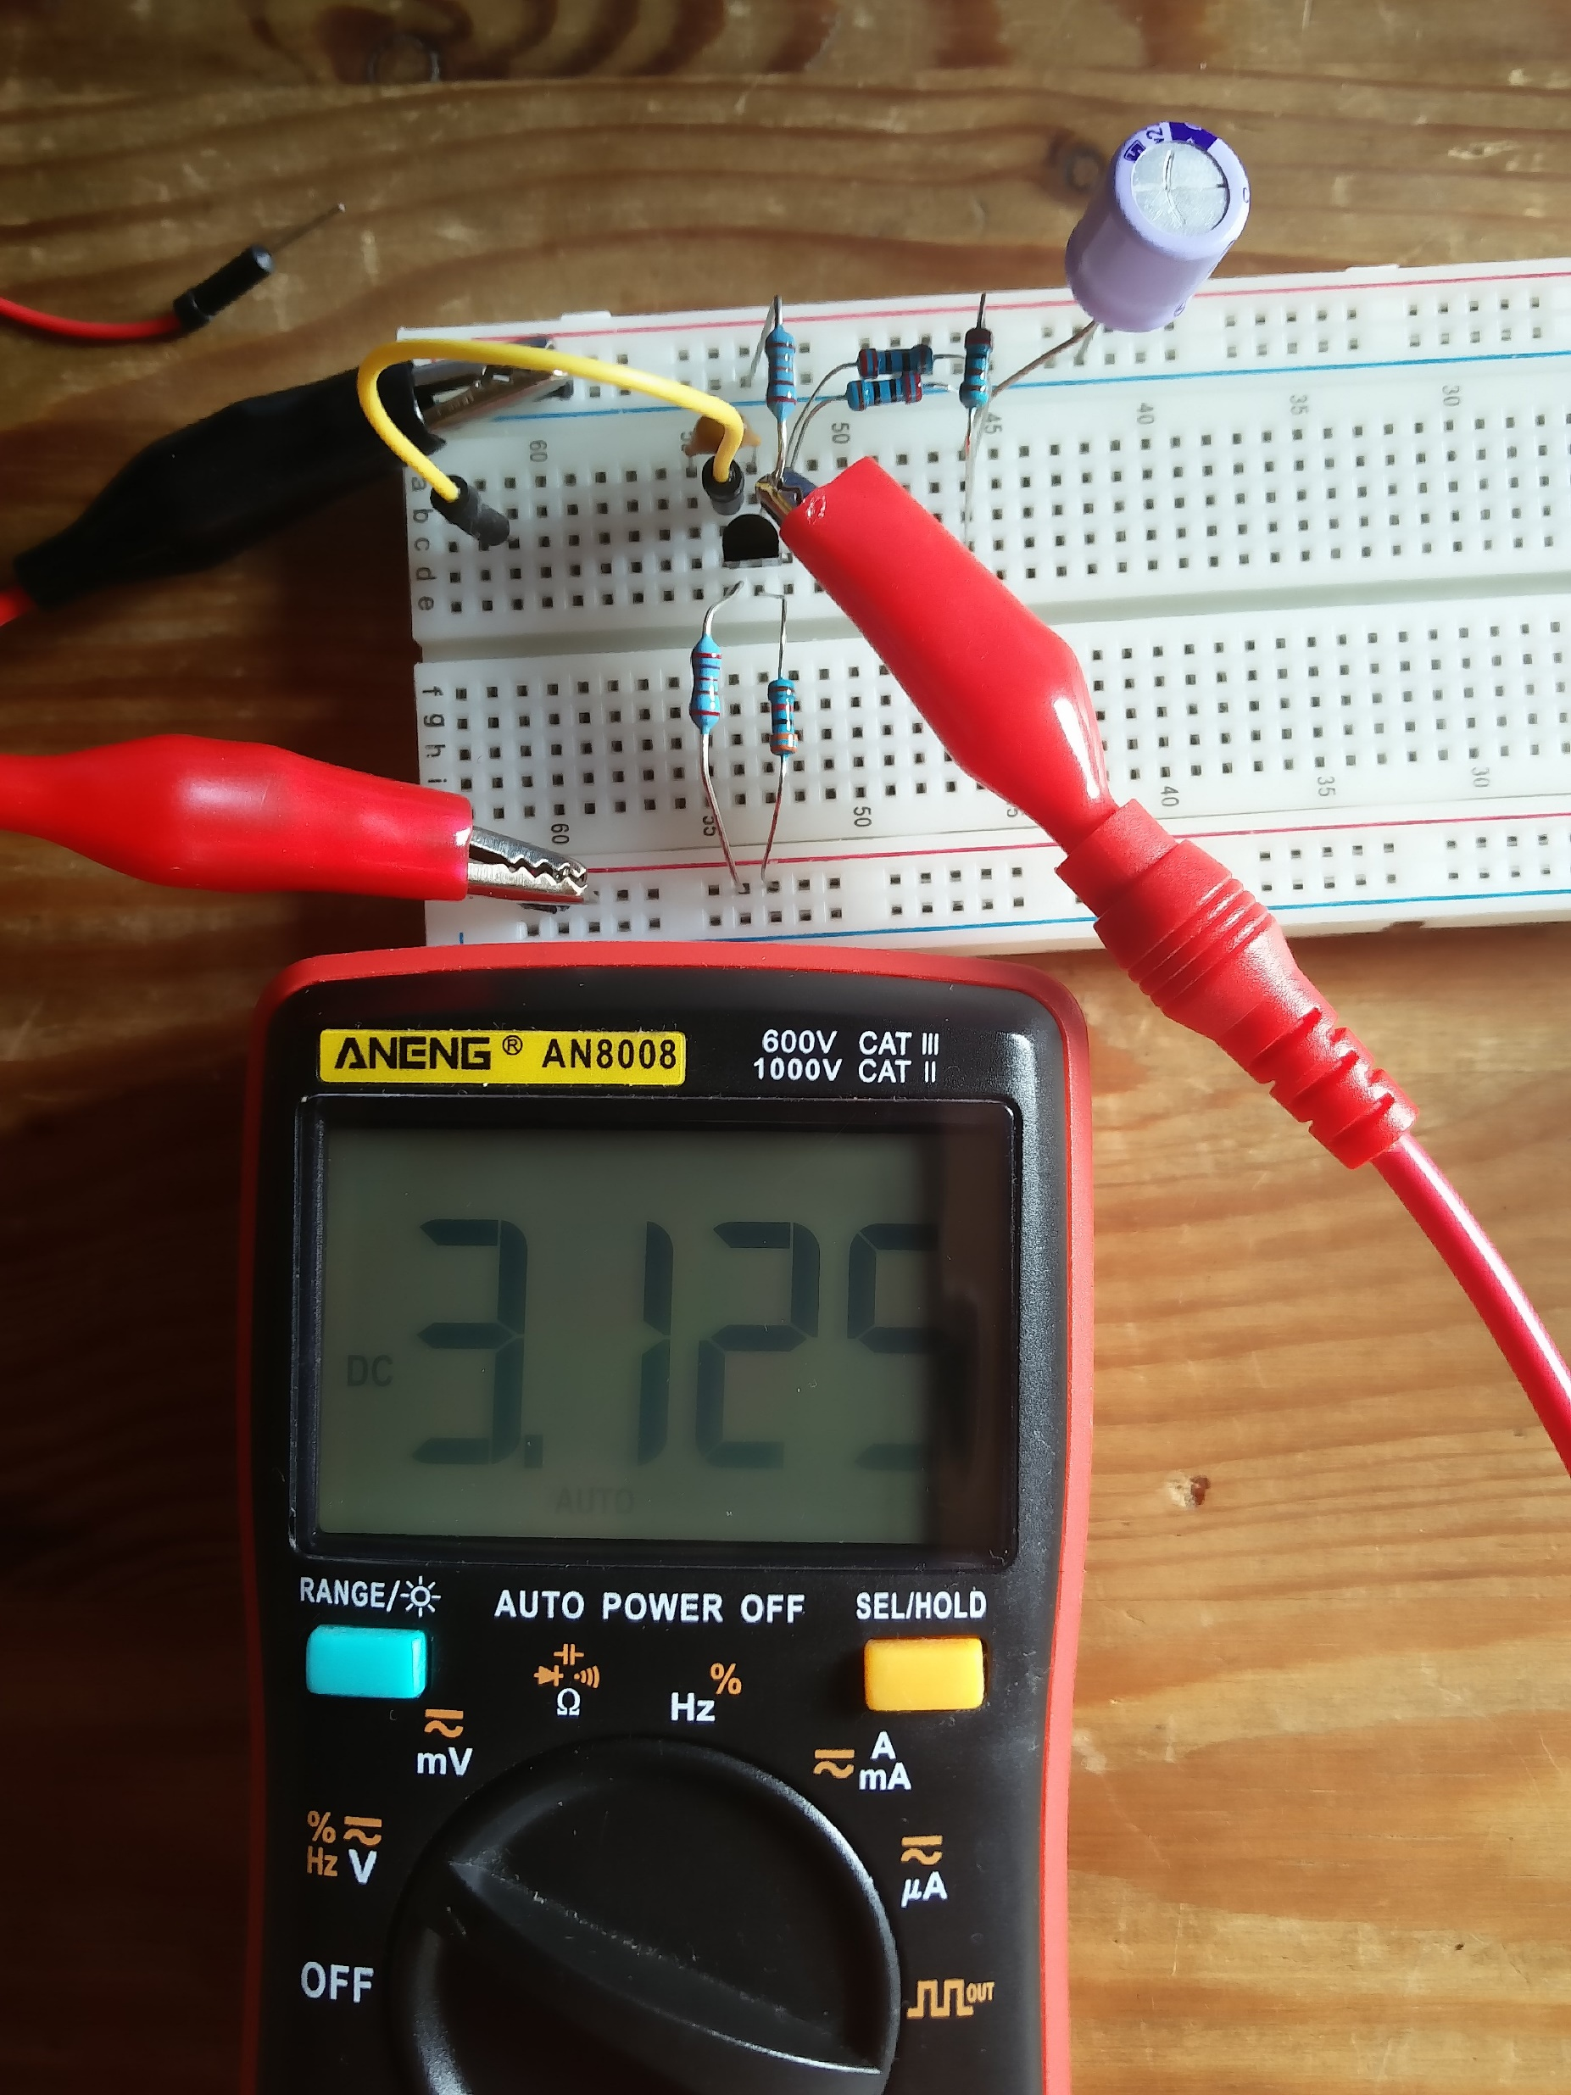
Base voltage = 3.13V

Slide 16
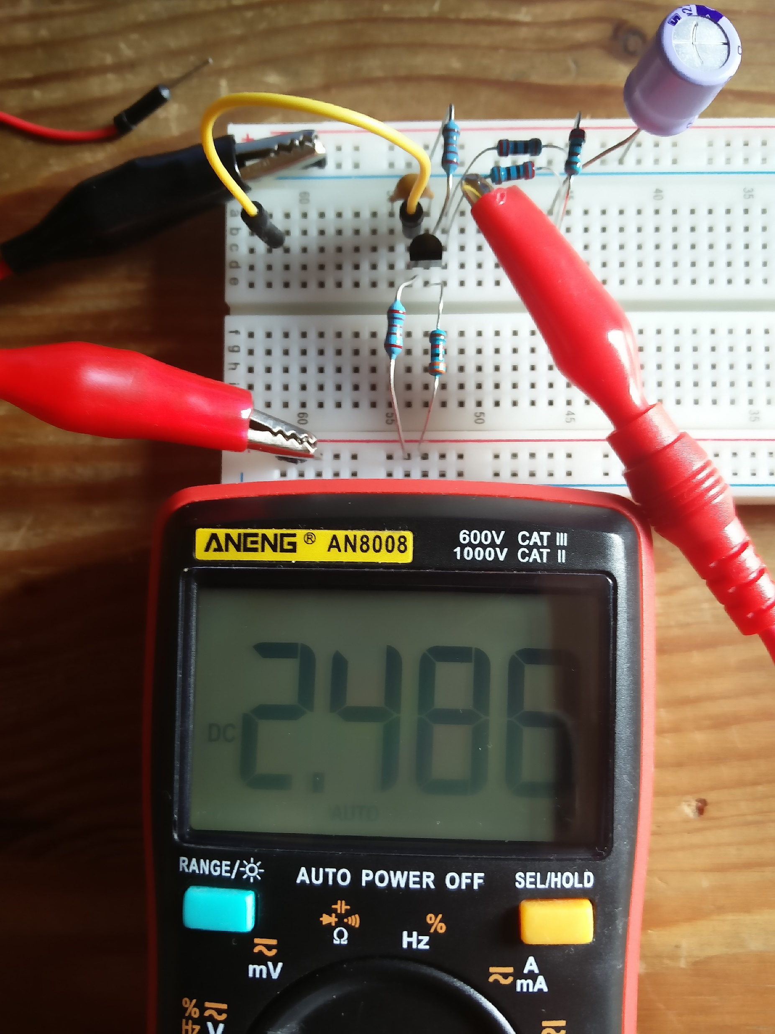
Emitter voltage = 2.49V

Slide 17
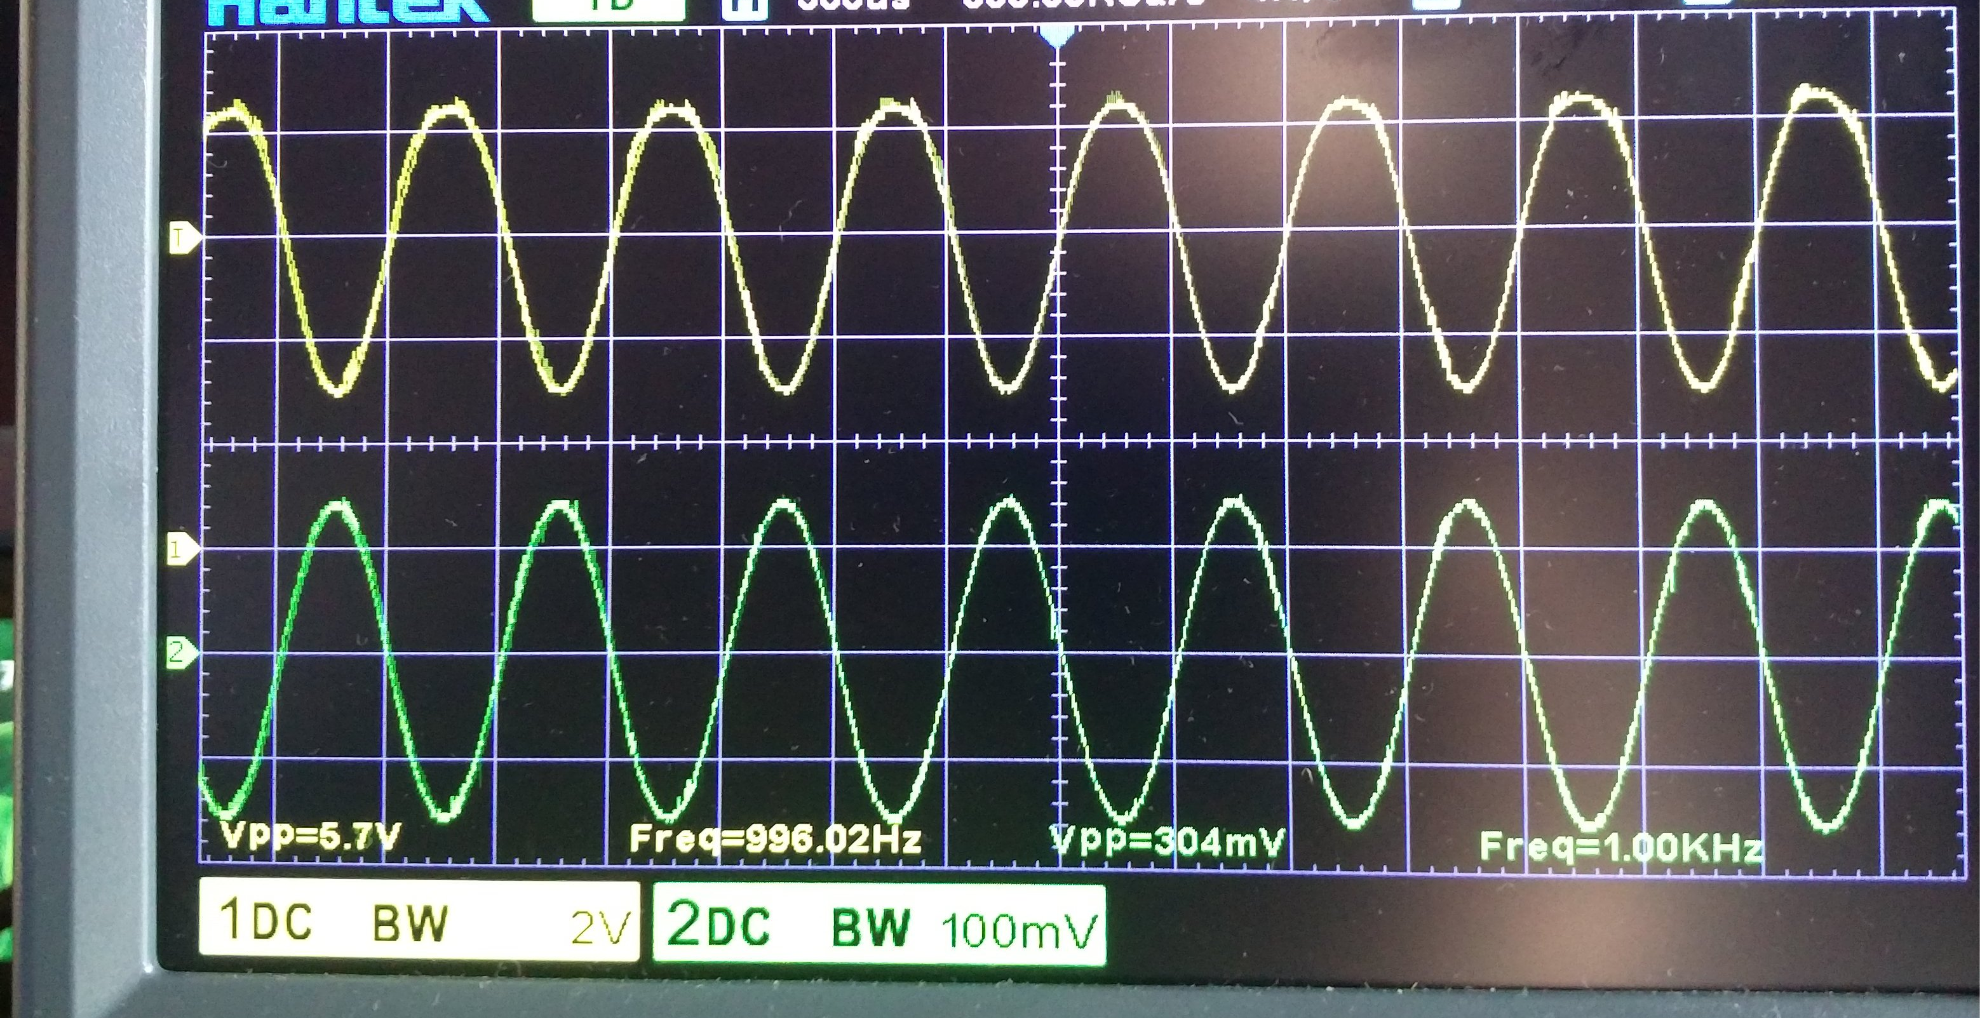
Input = 0.3Vpp @1KHz; Output = 5.7Vpp; Av = 19

Slide 18
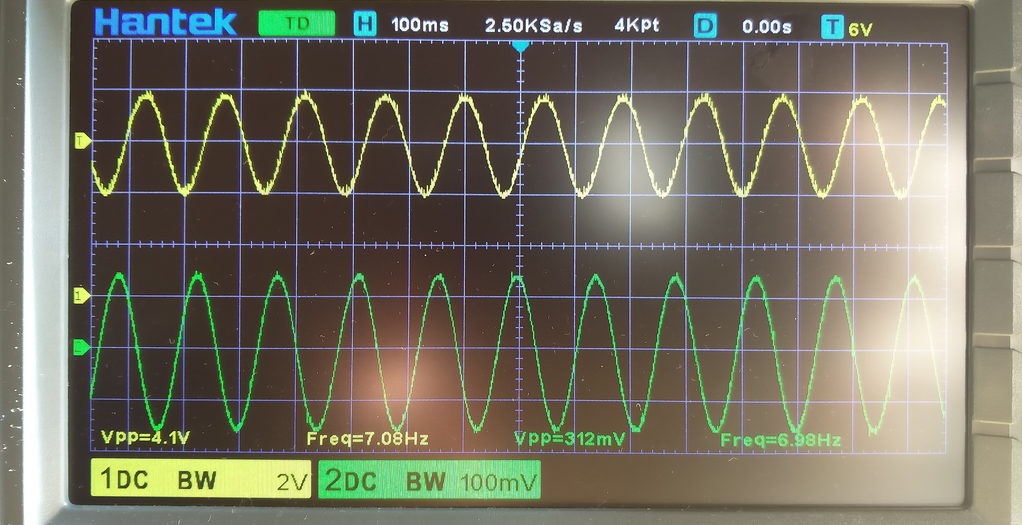
Input= 0.3Vpp @7Hz; Output = 4.1Vpp (-3dB)

Slide 19
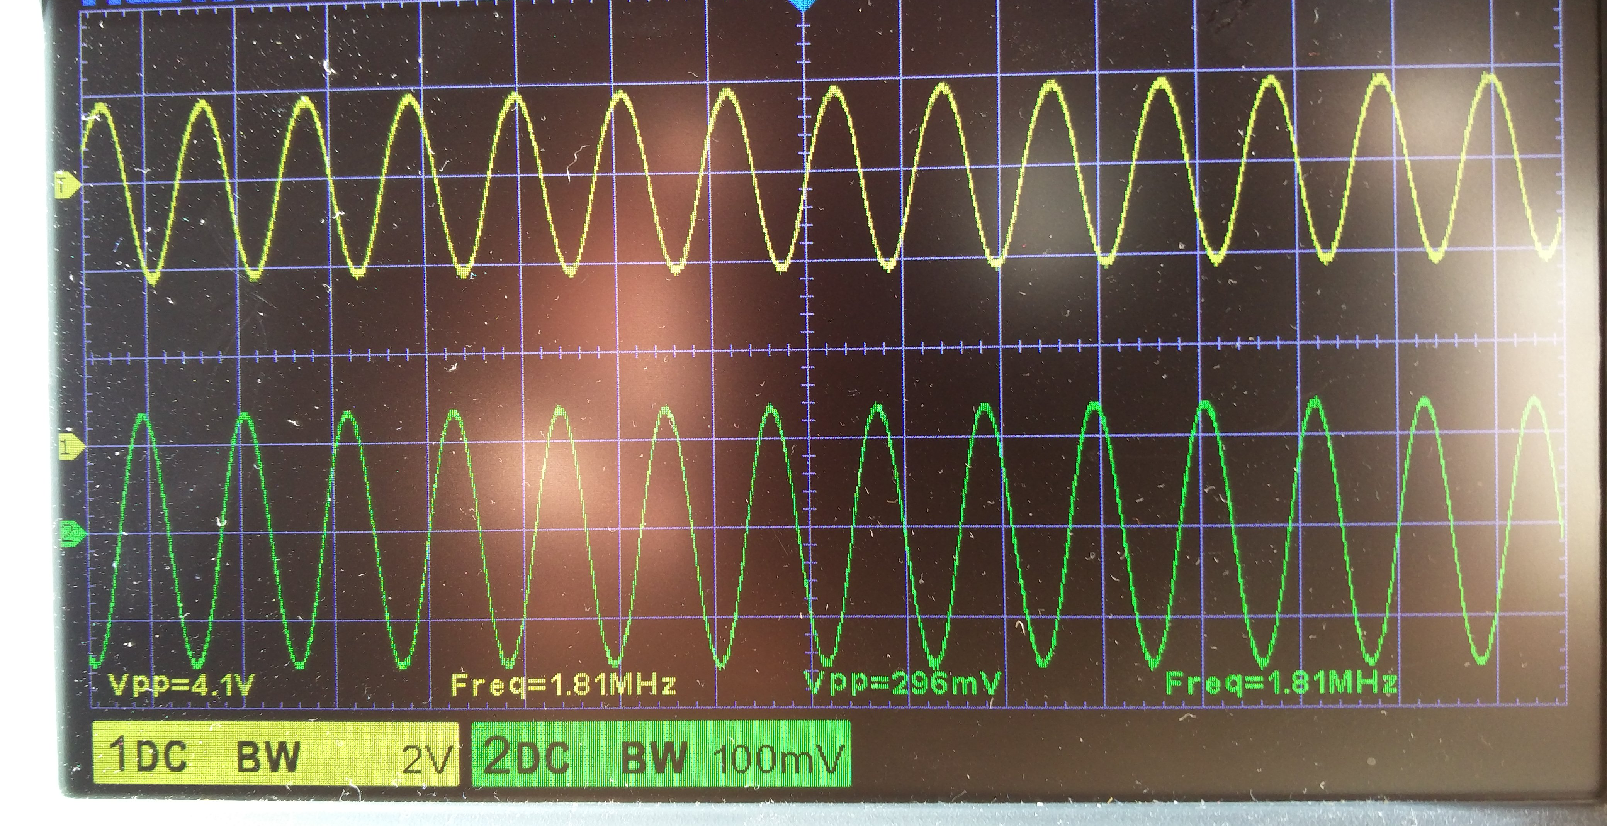
Input = 0.3Vpp @1.8MHz; Output = 4.1Vpp (-3dB)

Slide 20
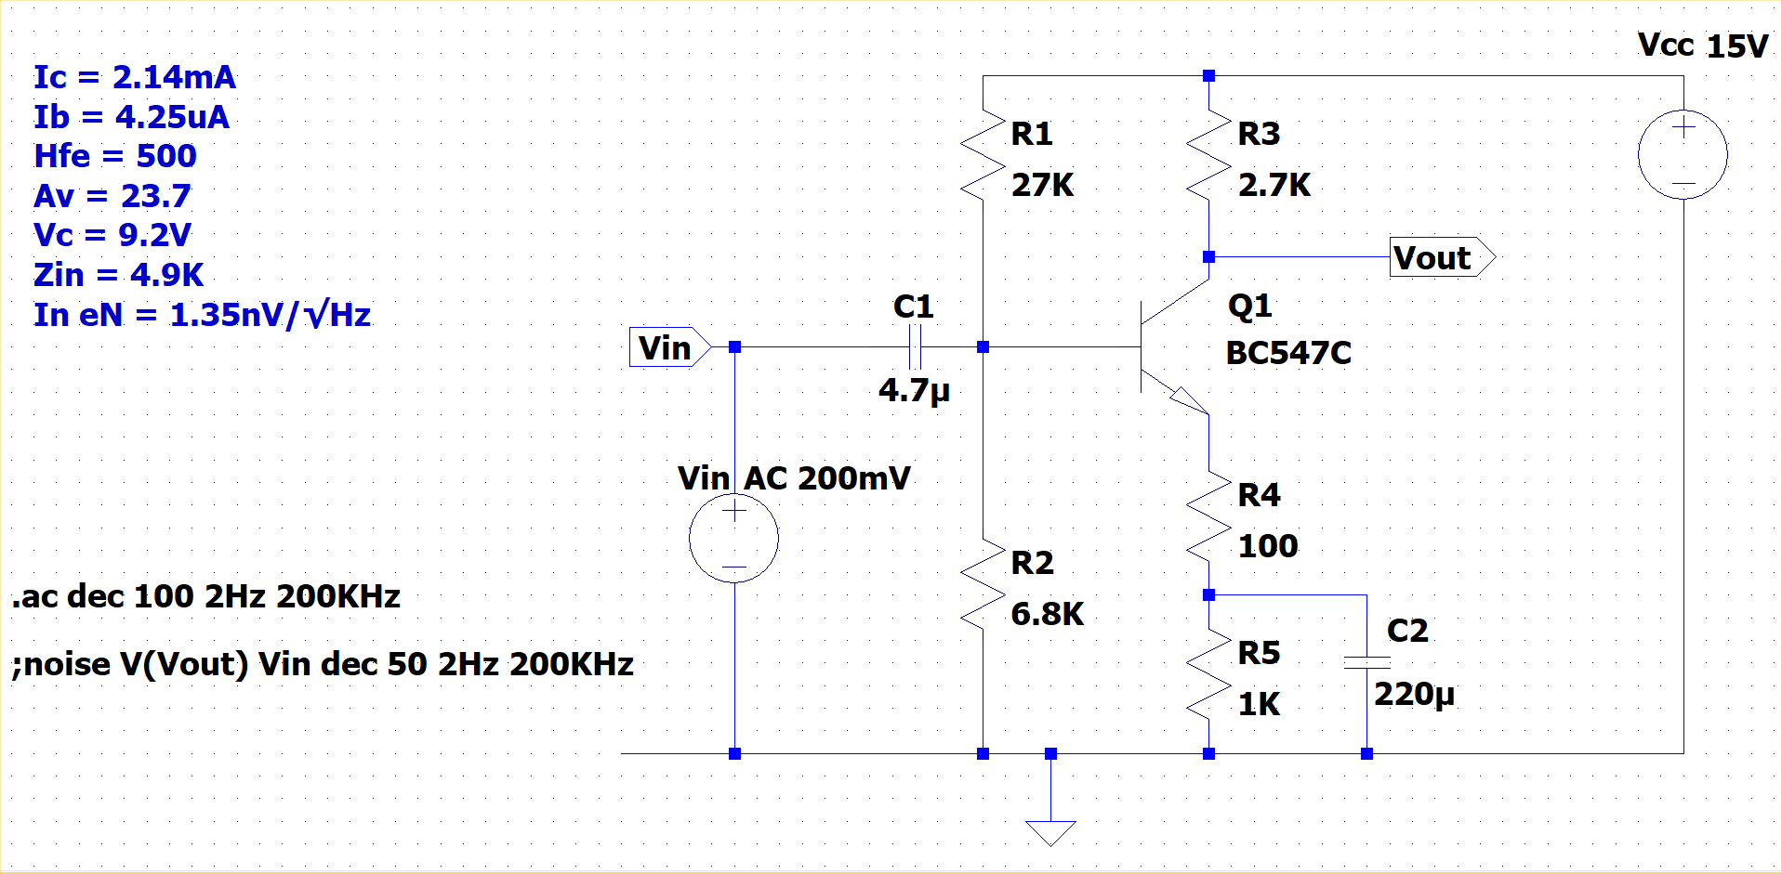
Increasing the collector current

Slide 21
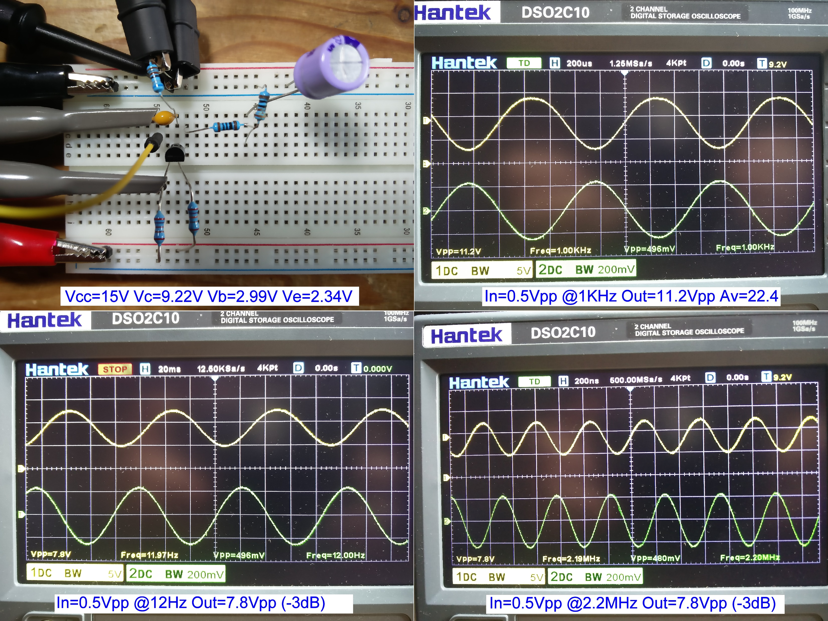
Actual circuit: Ic = 2.14mA

Slide 22
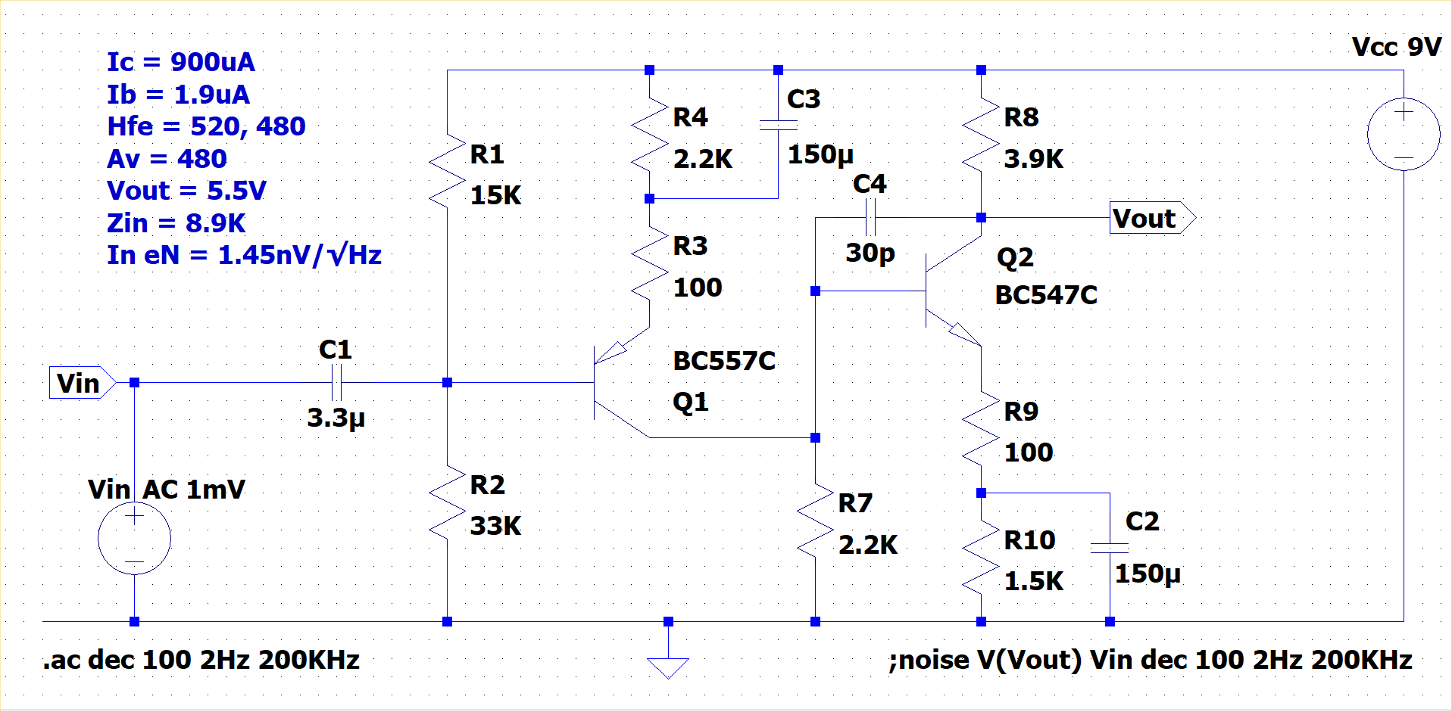
2-stage amplifier

Slide 23
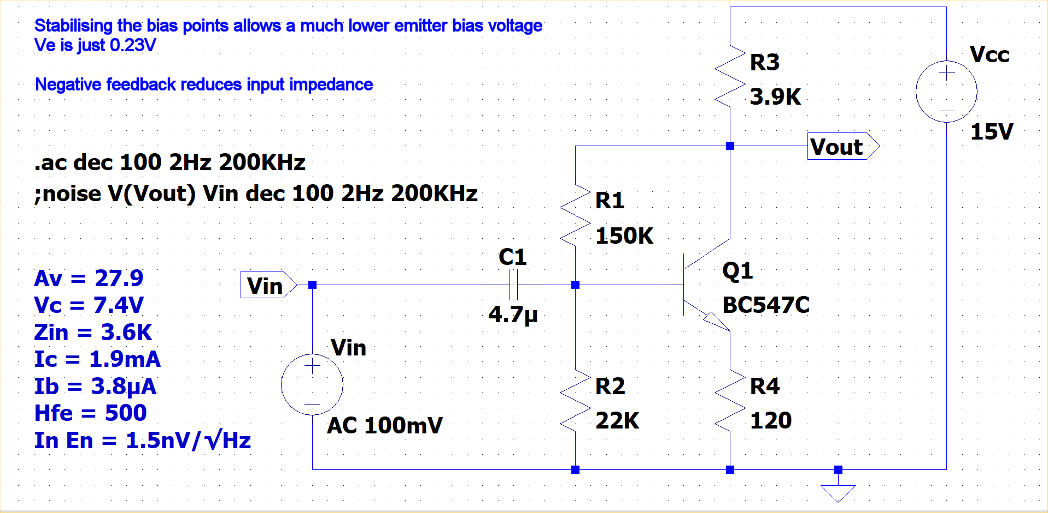
Feedback from collector to emitter

Slide 24
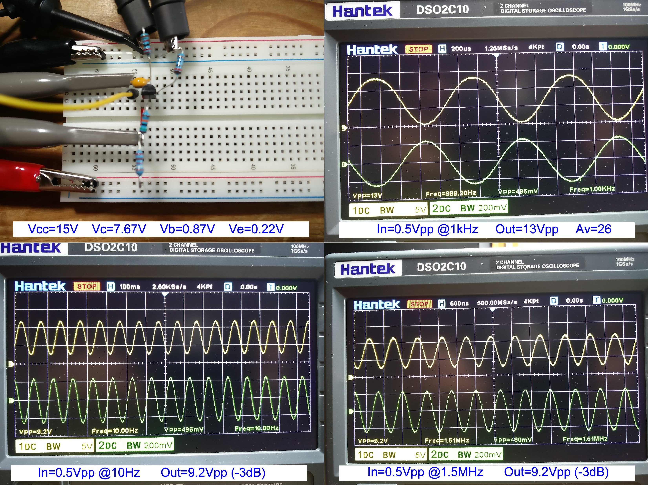
Actual circuit: Ic=1.9mA (C-B feedback)

Slide 25
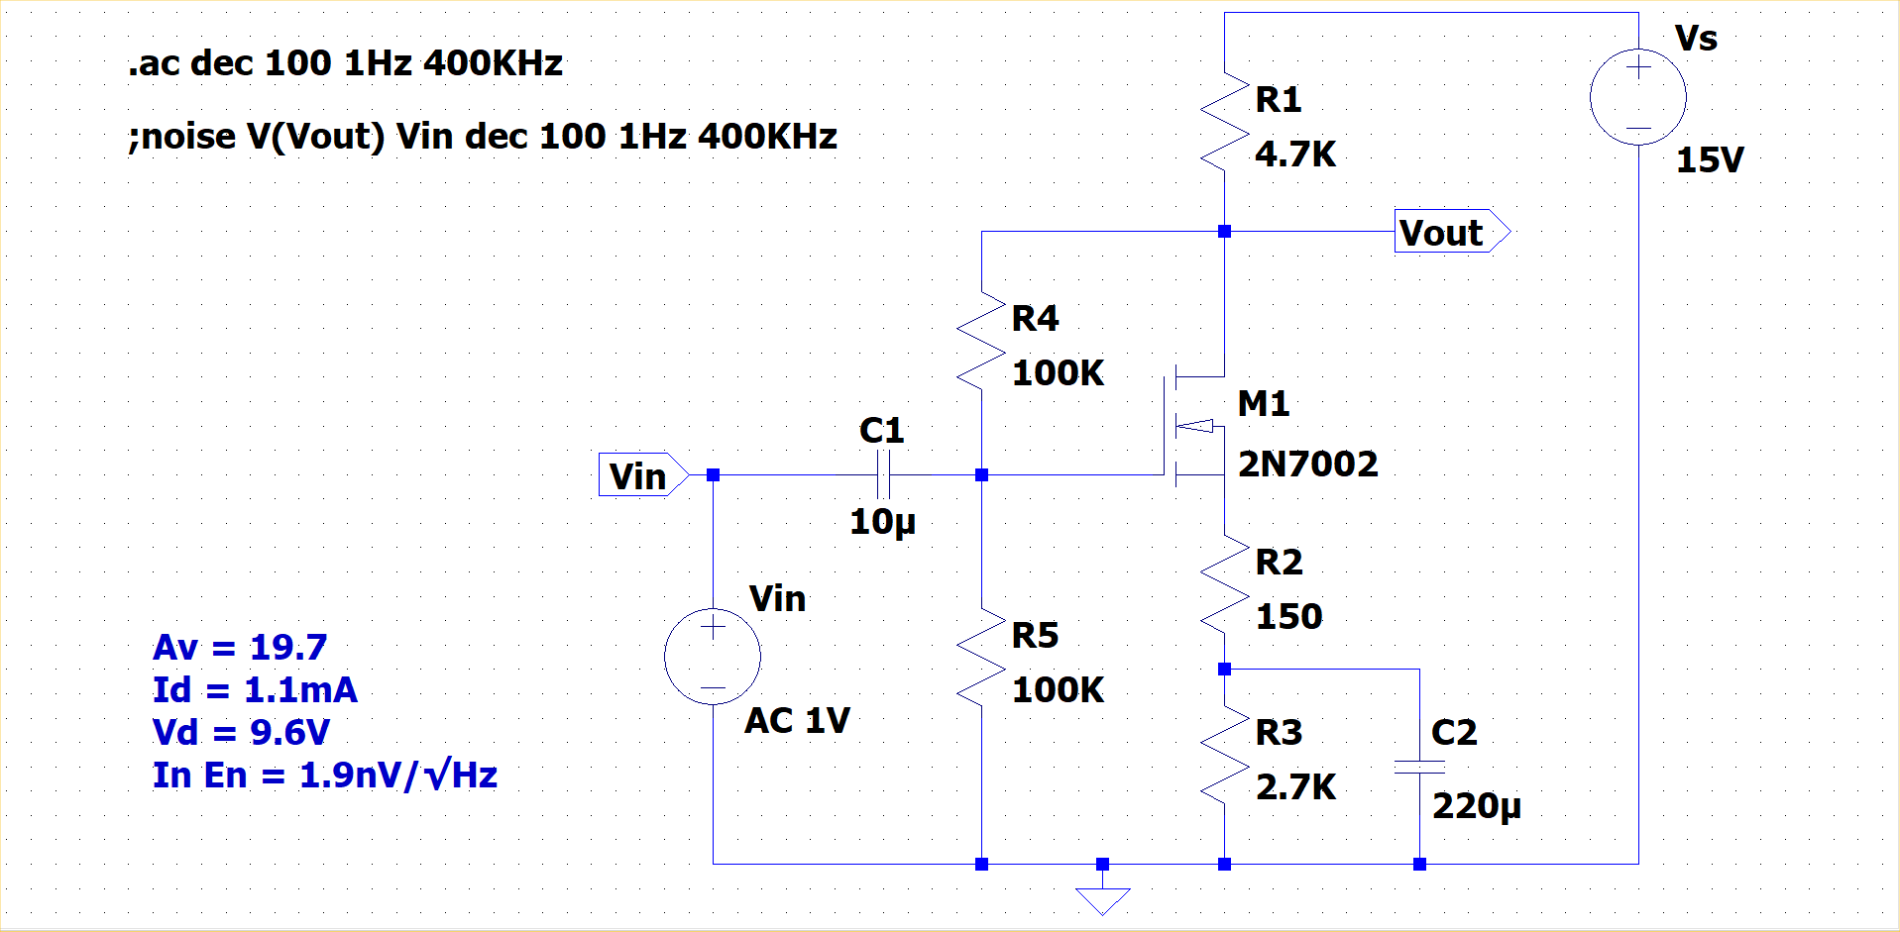
MOSFET common source biasing

